Slide 1
VIGNAN’S LARA INSTITUTE OF TECHNOLOGY & SCIENCE Department of Computer Science and Engineering Project review on SYSTEM FOR IDENTIFYING FAKE PRODUCT USING BLOCKCHAIN TECHNOLOGY
Under the esteemed guidance of
Mrs.J. Vidya M.Tech
Assistant Professor
CSE Department
Presented By
Batch No: C12
T.SANDHYA 19FE1A05D4
V.NEELIMA 19FE1A05G8
S.HEMCHAND 19FE1A05D1
T.MAHESH 19FE1A05G1

Slide 2

CONTENTS
Abstract
Introduction
Literature Survey
Existing System
Proposed System
System Architecture
Proposed Methodology
Results
Conclusion
References

Slide 3
ABSTRACT
Counterfeit items have become more prevalent in the industrial industry in recent years. This has an effect on the company's name, sales, and profit. Blockchain technology is used to authenticate and identify counterfeit items. Using blockchain technology, transactions are recorded in the form of blocks in a distributed, decentralized, and digital ledger. A block cannot be changed or hacked since blockchain technology is secure. Blockchain technology eliminates the need for customers or users to rely on third parties to verify the product's safety.

Slide 4
ABSTRACT
In light of current advancements in mobile and wireless technologies, quick response (QR) codes provide a promising technique for addressing the practice of counterfeiting in this project. This is done by scanning a QR code, which is linked to a Blockchain, to identify counterfeit goods. As a consequence, this method may be used to record product information and generate a unique identifier for each product in a database. It looks up the user's unique code in the Blockchain database and sees if there are any matches. When a code matches, the client will be notified; otherwise, the consumer will be notified that the product is counterfeit.

Slide 5
INTRODUCTION
The company's brand, revenue, and consumer health might be at jeopardy if a product or technology is made available to a global audience. The supply chain contains an endless number of things. In order to assess whether or not a product is authentic or a fake. As manufacturers are experiencing a major challenge so we can utilise blockchain technology to verify the authenticity of a product. Changing, hacking, or defrauding the system is difficult or impossible using Blockchain's data recording technique.

Slide 6
INTRODUCTION
In a blockchain, transactions are duplicated and propagated to all of the network's PC computers in the form of a record of transactions. Decentralized databases are known as Distributed Ledger Technology (DLT) and are maintained by huge groups of people (DLT). A. MOTIVATION There The distribution of counterfeit products has grown widespread in recent years. There are several counterfeit items in today's supply chain. According to the research, occurrences involving bogus products have increased in recent years.

Slide 7
INTRODUCTION
It is vital to have a system in place for consumers or users to verify all product facts in order for users to determine if the product is genuine or not. Currently, India lacks such a mechanism for detecting counterfeit items.Blockchain is a distributed ledger system that uses an immutable cryptographic signature known as a hash to record transactions. The blockchain will keep all transaction data in the form of blocks. A QR code generated for a particular product may be scanned by the end user to get further information about that product. We can tell if a thing is genuine or not by scanning its QR code.

Slide 8
INTRODUCTION
Motivation
There The distribution of counterfeit products has grown widespread in recent years. There are several counterfeit items in today's supply chain. According to the research, occurrences involving bogus products have increased in recent years. It is vital to have a system in place for consumers or users to verify all product facts in order for users to determine if the product is genuine or not. Currently, India lacks such a mechanism for detecting counterfeit items

Slide 9
INTRODUCTION
Objective
The growth in counterfeit goods sparked the idea for this project. Following are the project's goals:
1.An anti-counterfeit system based on blockchain technology is being developed.
2. To use a QR code to encrypt product information.
3. Customers' security is ensured by supplying them with their own data.

Slide 10
LITERATURE SURVEY
Si Chen, Rui Shi, Ren, Jiaqi Yan, Yani Shi, “A Blockchain-based Supply Chain Quality Management Framework”, 14th, IEEE International Conference on e-Business Engineering, 2017.
Blockchain Based Fake Product Identification in Supply Chain www.irjet.net: Ajay Funde, Pranjal Nahar, Ashwini Khilari.
Fake News Detection In Social Media using Blockchain: - Shovon Paul, Jubair Joy, Shaila Sarkar.
A Blockchain-Based Application System for Product Anti-
Counterfeiting (IEEE Access): Jinhua Ma, Xin Chen, hung-Min Sun.

Slide 11
LITERATURE SURVEY
Table
S.NO | Title | Algorithm | Limitations | Proposed methodology
1. | A Blockchain-based Supply Chain Quality Management Framework | A blockchain based SCQI (supplier continuous quality improvement) framework | Lack of data privacy | provides intelligent quality management of supply based on blockchain technology
2. | Blockchain Based Fake Product Identification in Supply Chain | POMS (product ownership management system) , IPFS(inter planetary file system) | Public blockchains have limits on the amount of data | End user can scan QR code assigned to a product and can get all the information

Slide 12
LITERATURE SURVEY
Table
3. | Fake News Detection In Social Media using Blockchain | Ethereum , DLT(distributed ledger technology) | Did not detect news which causes obstruction to the government | detect fake news
4. | A Blockchain-Based Application System for Product Anti- Counterfeiting | Hashing and encryption | Can be affected due to bad network | Detect counterfeit items

Slide 13
EXISTING SYSTEM
The existing system uses machine learning techniques for detecting the fake products.
The implementation consists of two steps: training models step and detecting logo step. In the first step, the training model component depicts a way we prepare dataset and select the Deep Learning pre-trained detection model. The more data we have, the higher the accuracy of our model can perform. After collecting dataset, we label our raw data by using annotation tools (i.e., and divide them into a training set (80%) and test set (20%). The collecting-labelling is not a one-time process.

Slide 14
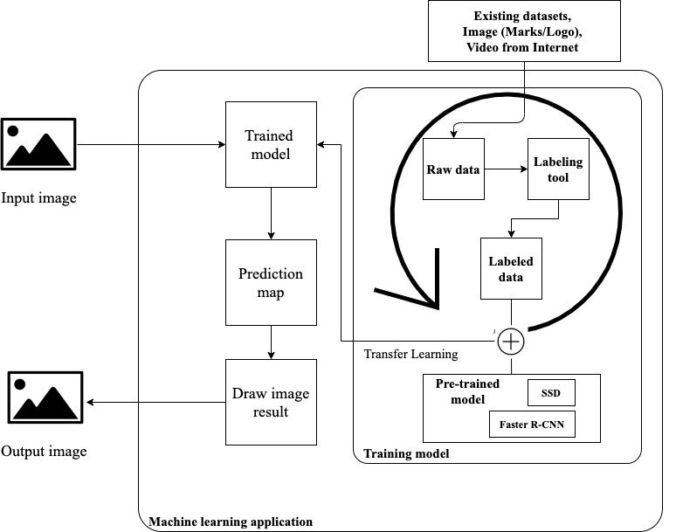
EXISTING SYSTEM

Slide 15
EXISTING SYSTEM
Two pre-trained models are used in our transfer learning are SSD300 - Regression/Classification based family- and Faster R-CNN Resnet101 – Region-based family-. Based on (Zhao, et al., 2019), Faster RCNN archive high accuracy (mean Average precision of 83.8% by testing on VOC 07 Test set) with low training speed. It also focuses on handling request from the webserver (product images with mark/logo) and returns detection result.

Slide 16
PROPOSED SYSTEM
Blockchain technology may be beneficial in resolving such issues. The project's primary objective is to assist individuals in determining if a product is genuine or counterfeit.
REQUIREMENT SPECIFICATION
A. ANDROID STUDIO
Based on IntelliJ's IDEA framework, Android Studio has
been made by Google as their official integrated
development environment (IDE) [21]. Figure 1 shows the
android studio.

Slide 17

PROPOSED SYSTEM
B. FIREBASE CLOUD
Firebase is Google's platform for building mobile and web applications. When it first started in 2011, it was a standalone company. As of 2014, the platform has become Google's main offering for app development.

Slide 18
SYSTEM ARCHITECTURE
The project's primary objective is to assist individuals in determining if a product is genuine or counterfeit. We presented a solution for detecting counterfeit items based on blockchain technology as an Android application. The suggested approach guarantees that counterfeit items are detected in everyday life. The suggested system is composed of three major components: an Android application for the consumer or user, an Android application for the manufacturer or corporation, and a cloud/database.

Slide 19

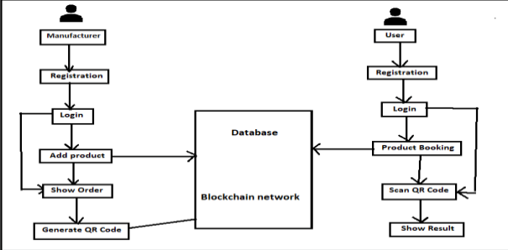
SYSTEM ARCHITECTURE

Slide 20
SYSTEM ARCHITECTURE
Manufacturers and enterprises are the first to apply, and we must first register with them. After registering and login into the application, we have a few options. One option is to provide a product that can be customised by the manufacturer. They can examine the customer's order details and then determine whether or not to accept or reject the transaction if they want to show the order. Additional monitoring may be done by the manufacturer to see whether or not the items are delivered.

Slide 21
SYSTEM ARCHITECTURE
A second programme is the Customer application, which requires us to first register in-app before logging in with our id and password. This programme has a feature that allows users to see product data such as the product's name, total amount, price, and manufacturer information.In that, we may create a product book by entering the product's amount.This feature allows us to view product data such as name, amount, date, time, price, and the status of a product that has been manufactured, whether it has been delivered or not. This programme has a QR code scanner that allows us to scan the QR code of a product and determine if it is genuine

Slide 22
PROPOSED SYTEM METHODOLOGY
SHA -256 is a variation of that algorithm. A method known as SHA-256 creates a 256-bit long hash value.
1] The Sha-256 method is employed in the blockchain to generate a consistent 256-bit hash each time. Additionally, this technique is a component of encryption technology.
2] The graphic depicts the algorithm's prototype. This contains some data termed IV, which is 256 bits in length. Now, the feedback we get will be massive. As a result, divide it into 512-bit chunks.

Slide 23
PROPOSED SYTEM METHODOLOGY
3] A part of the input will be preserved since there will be no input that is exactly 512 bits. Adding a 10-bit padding concatenation to the left input completes the operation. We may proceed now that our input has been converted to a perfect multiple.
5] The 768-bit result is obtained by multiplying the 512-bit input by the 256-bit IV. The function 'c' is used to compress these 768 bits into a 256-bit output.
6] This 256-bit output is blended once again with the 512-bit input from block B2.
7] Once again, the sum is compressed to provide a 256-bit output. This cycle continues until the last block is filled (block n).

Slide 24
RESULTS
Real-time technology may be utilised to assess whether the product is authentic or not. The SHA-256 method is used by the manufacturer to produce a QR code in blockchain technology. The user scans the QR code to see whether the product is real or a fake.

Slide 25
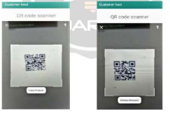
RESULTS
Images for the results:

Slide 26
CONCLUSION
With the large volume of counterfeit items available online, counterfeit products are expanding quickly. There is a pressing need to detect counterfeit goods, and blockchain technology is being used to accomplish this goal. Additionally, the data is encoded as a QR code. Customers or consumers may discover counterfeit products by scanning the QR code.

Slide 27
CONCLUSION
In blockchain technology, digital information on items may be kept in the form of blocks. Firebase cloud storage may be used to store the data. Thus, the suggested approach benefits the client by detecting counterfeit items across the supply chain. It is possible to access information about the product's history and present owner by scanning the QR codes that have been affixed to it.

Slide 28
REFERENCES
[1] Si Chen, Rui Shi, Ren, Jiaqi Yan, Yani Shi, “A Blockchain-based Supply Chain Quality Management Framework”, 14th, IEEE International Conference on e-Business Engineering, 2017.
[2] Blockchain Based Fake Product Identification in Supply Chain www.irjet.net: Ajay Funde, Pranjal Nahar, Ashwini Khilari.
[3] Fake News Detection In Social Media using Blockchain: - Shovon Paul, Jubair Joy, Shaila Sarkar.
[4] A Blockchain-Based Application System for Product AntiCounterfeiting (IEEE Access): Jinhua Ma, Xin Chen, hung-Min Sun.

Slide 29
REFERENCES
[5] Q. Lu and X. Xu, ``Adaptable blockchain-based systems: A case study for product traceability,'' IEEE Softw., vol. 34, no. 6, pp. 21_27, Nov./Dec. 2017.
[6] P. William, A. Choubey, G. S. Chhabra, R. Bhattacharya, K.Vengatesan and S. Choubey, "Assessment of Hybrid Cryptographic Algorithm for Secure Sharing of Textual and Pictorial Content," 2022 International Conference on Electronics and Renewable Systems (ICEARS), 2022, pp. 918-922, doi: 10.1109/ICEARS53579.2022.9751932.

Slide 30
THANK YOU

